Slide 1
Feasibility Analysis
Slide ‹#›
Notes:
‹#›

Slide 2
Key Ideas
Projects initiated to create business value from using information technology.
Business needs:
Lower cost/Increase revenue
Improve customer service
Use latest/emerging technologies
…
Slide ‹#›

Slide 3
Key Ideas
A system request presents
a brief summary of a business need
explains how a system that supports the need will create business value.
The project sponsor is a key person
Recognize business need
Understand business value
Adoption of new IT
Want system to succeed
The approval committee
reviews proposals from various groups and units
Approve/decline/suspend projects
Slide ‹#›

Slide 4
IDENTIFYING BUSINESS VALUE
Slide ‹#›

Slide 5
Business value
Tangible value can be quantified and measured easily, e.g.
2% reduction in operating costs
5% increase in sales
Intangible value – system provides important but hard-to-measure benefits, e.g.
improved customer service
better competitive position
Slide ‹#›

Slide 6
System Request
Describes business reasons for building a system – the business value
Project sponsor prepares the document
Approval committee reviews and judges the system request
Slide ‹#›

Slide 7
System Request
Lists key elements of the project
Project sponsor
Business need
Business requirements
Business value
Special issues or constraints
Slide ‹#›
Notes:
‹#›

Slide 8
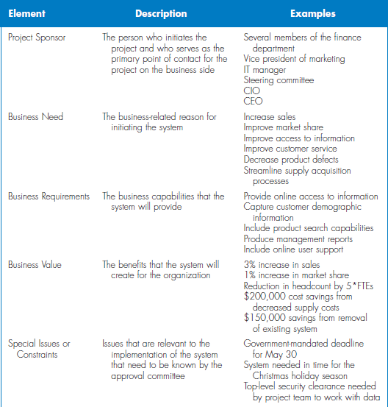
Slide ‹#›

Slide 9
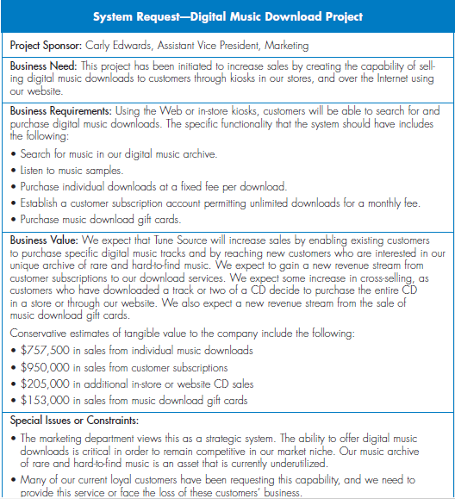
Slide ‹#›

Slide 10
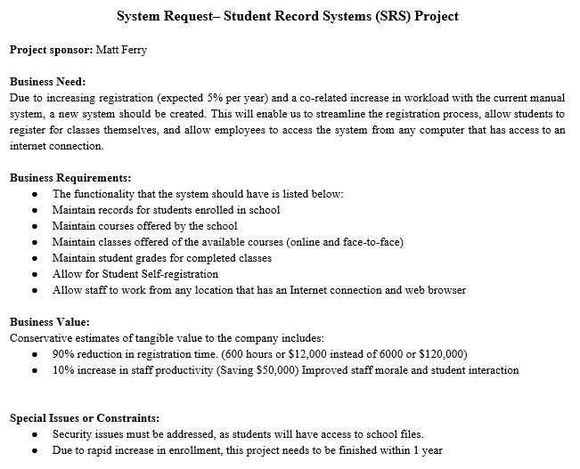
Slide ‹#›

Slide 11
Your Turn
If you were building a web-based system for course enrollment --
What would be the functionality?
What would be the expected value?
What special issues or constraints would you foresee?
Slide ‹#›

Slide 12
FEASIBILITY ANALYSIS
Slide ‹#›

Slide 13
Key Ideas
Feasibility analysis is used to aid in the decision of whether or not to proceed with the IS project.
Also identifies project risks
Can be revised throughout SDLC
Slide ‹#›

Slide 14
Feasibility Analysis
Detailing Expected Costs and Benefits
Technical feasibility
Economic feasibility
Organizational feasibility
Slide ‹#›
Notes:
‹#›

Slide 15
Technical Feasibility: Can We Build It?
Familiarity with application
Knowledge of business domain
Familiarity with technology
Extension of existing firm technologies
Project size
Number of people, time, and features
Compatibility
Ease of integrating the system with the company’s existing technology
Slide ‹#›

Slide 16
Economic Feasibility Should We Build It?
Perform cost benefit analysis
Identify costs and benefits
Assign values
Calculate cash flow and ROI
Development costs
Annual operational costs
Annual benefits
Intangible costs and benefit
Slide ‹#›

Slide 17
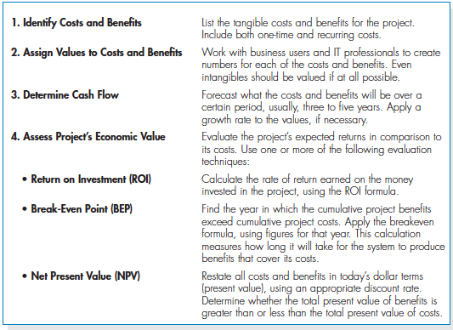
Economic Feasibility Steps
Slide ‹#›
Notes:
‹#›

Slide 18
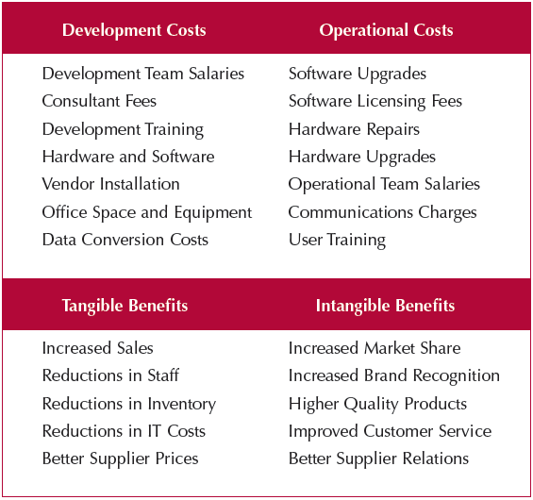
Example Cost & Benefits
Slide ‹#›

Slide 19
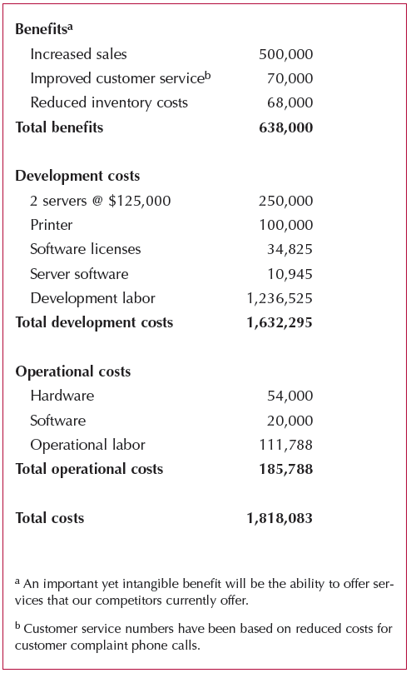
Assign Values
Slide ‹#›

Slide 20
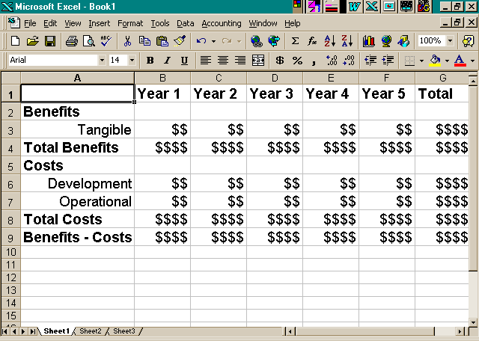
Cash Flow Method for Cost Benefit Analysis
Slide ‹#›

Slide 21
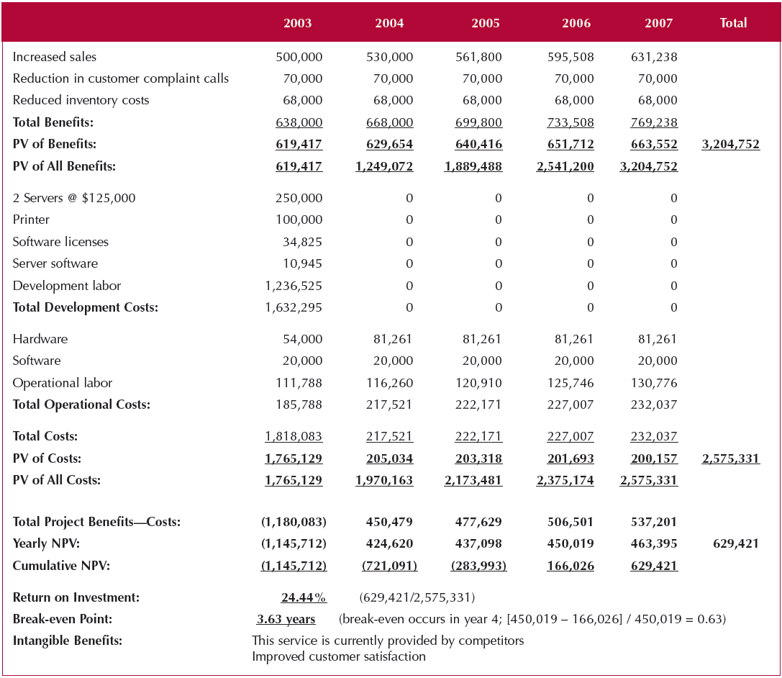
Cost-Benefit Analysis
Slide ‹#›

Slide 22
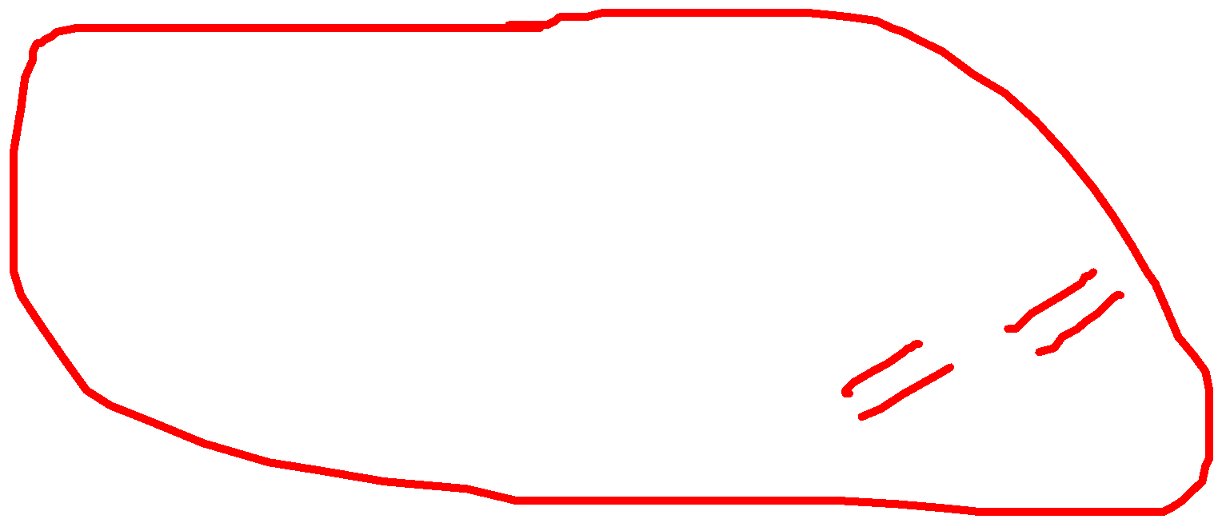

Present Value Calculation
PRESENT VALUE EQUALS
Cash flow amount
Divided by
(1 + interest rate)^{n}
Where “n” equals the number of periods
$100 received in 3 years with a required rate of return of 10% has a PV of $75.13.
Slide ‹#›

Slide 23

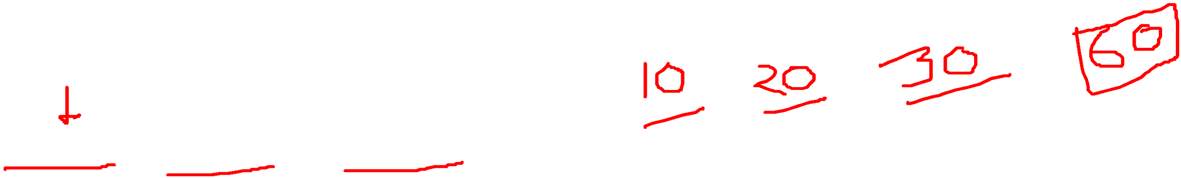
Net Present Value (NPV)
The NPV is simply the difference between the total present value of the benefits and the total present value of the costs.
500000 252100
Slide ‹#›

Slide 24
Return on Investment (ROI)
Measures money received in return for money invested
High ROI is desirable when benefits exceed costs
Can be determined per year, or for entire project completion period
Slide ‹#›

Slide 25
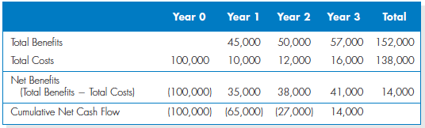
Return on Investment Calculation
Slide ‹#›

Slide 26
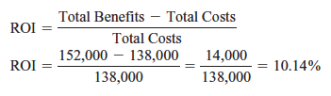
Return on Investment Calculation
Slide ‹#›

Slide 27
Break-Even point
Length of time when returns will match amount invested
Greater time -> Greater risks
Easier to picture graphically – plot cumulative present value of benefits and costs for each year
Slide ‹#›

Slide 28


Break-Even point
Slide ‹#›

Slide 29
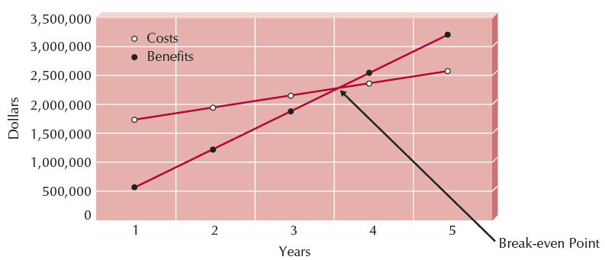
Break-Even Graph
Slide ‹#›

Slide 30
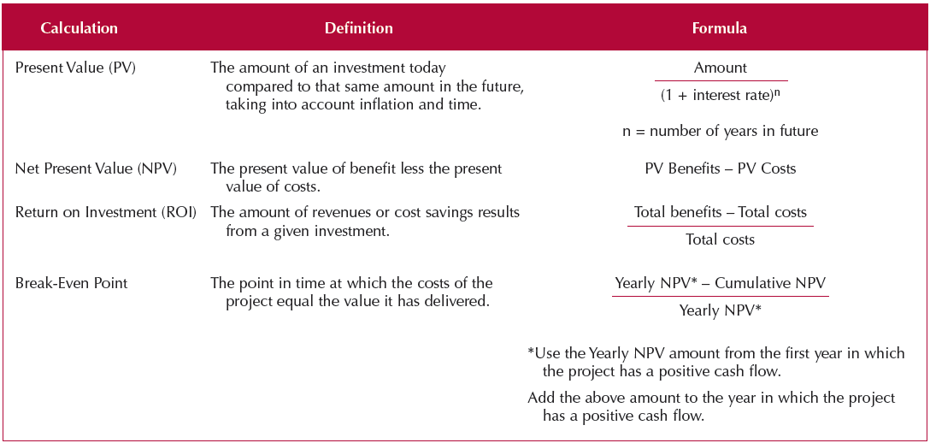
Formulas
Slide ‹#›

Slide 31
Organizational Feasibility If we build it, will they come?
Will the users accept the system?
Will it be incorporated in the organization?
How to asses?
1. Check Strategic Alignment – fit between project and business strategy?
Slide ‹#›

Slide 32
Organizational Feasibility If we build it, will they come?
2. Perform Stakeholder Analysis
Stakeholder – any person, group, or organization that can affect or will be affected by the system
Stakeholder analysis considers
Project champion(s)
Organizational management
System users
Slide ‹#›

Slide 33
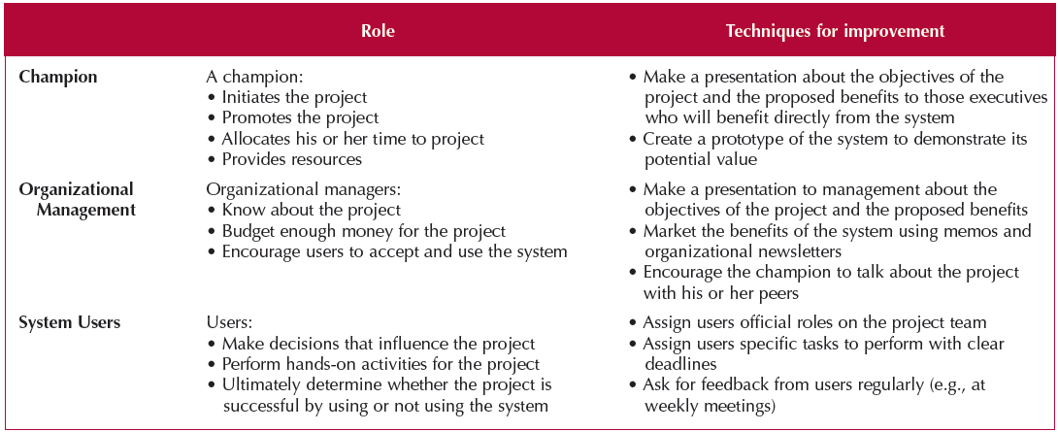
Stakeholders
Slide ‹#›

Slide 34
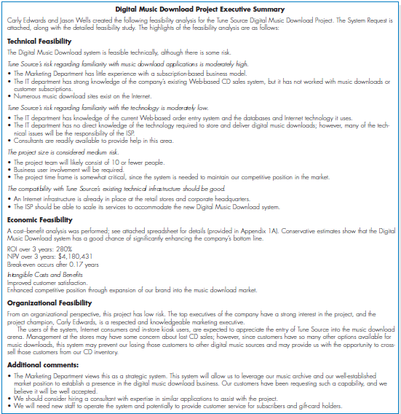

Slide 35
Summary
Project initiation involves creating and assessing goals and expectations for a new system
Identifying the business value of the new project is a key to success
The system request describes an overview of the proposed system.
The feasibility study is concerned with ensuring that technical, economic, and organizational benefits outweigh costs and risks
Slide ‹#›

